Slide 1
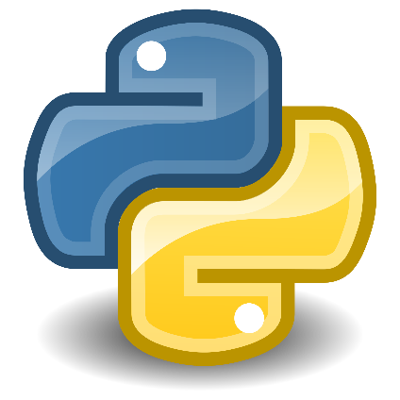


Class: X Lab: 14
Python
Modules

Slide 2



Modules
A file containing
a set of functions
you want to
include in your
application

Slide 3
Create a Module
To create a module just
save the code you want in a file with the file extension .py
def greeting(name): print("Hello, " + name)

Slide 4
Use a Module
we can use the module we just created, by using the import statement
import mymodule mymodule.greeting("Jonathan")

Slide 5
Use a Module
we can use the module we just created, by using the import statement
import mymodule mymodule.greeting("Jonathan")

Slide 6
Variables in Module
person1 ={ "name": "John", "age": 36, "country": "Norway" }
The module can contain functions, as already described, but also variables of all types (arrays, dictionaries, objects etc

Slide 7
Renaming a Module
import mymodule as mx a = mx.person1["age"] print(a
You can create an alias when you import a module, by using the as keyword

Slide 8
